Slide 1



Consumer Goods
Ad_Hoc Insight
SQL Challenge

Slide 2

About Company
Atliq Hardwares is one of the leading computer hardware producers in India and well expanded in other countres too.
Problem Set
the management noticed that they do not get enough insights to make quick and smart data-informed decisions.

Slide 3
Requests: 1
Provide the list of markets in which customer "Atliq Exclusive" operates its business in the APAC region.
MySql Query:
select distinct(market) from dim_customer where customer="Atliq Exclusive" and region="APAC";

Slide 4
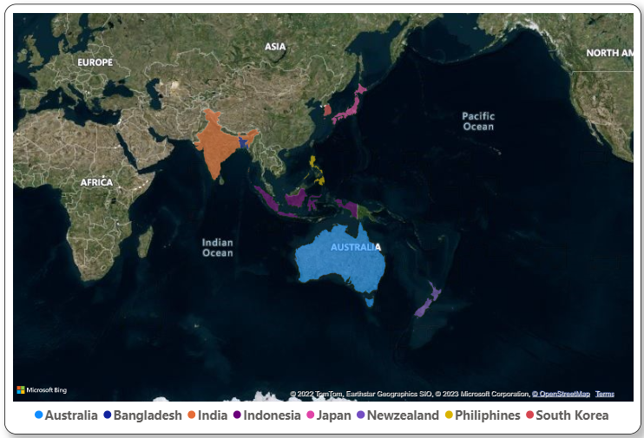
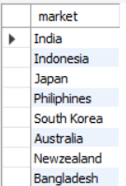
Output:
Insights:
"Atliq Exclusive" operates its business in eight markets in the APAC region, which are India , Indonesia ,Japan, the Philippines ,South Korea , Australia, New Zealand, and Bangladesh.

Slide 5
Requests: 2
What is the percentage of unique product increase in 2021 vs. 2020? The final output contains these fields, unique_products_2020 unique_products_2021 percentage_chg .
MySql Query:
WITH cte AS ( SELECT COUNT(distinct p.product_code) AS unique_products_2020 FROM dim_product p
JOIN fact_manufacturing_cost m ON p.product_code = m.product_code WHERE cost_year =2020), cte1 AS ( SELECT COUNT(DISTINCT p.product_code) AS unique_products_2021 FROM dim_product p JOIN fact_manufacturing_cost m ON p.product_code = m.product_code WHERE cost_year =2021)SELECT cte.unique_products_2020, cte1.unique_products_2021, (cte1.unique_products_2021 - cte.unique_products_2020) / cte.unique_products_2020 * 100 AS percentage_chgFROM cte, cte1;

Slide 6

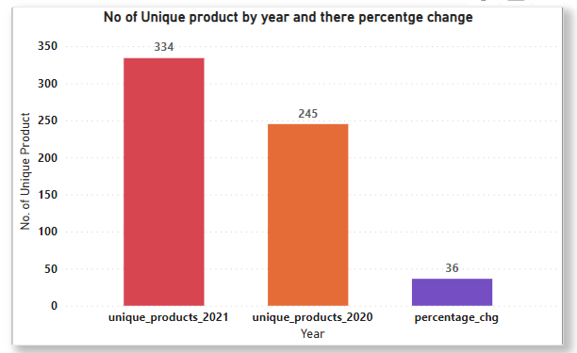
Output:
Insights:
In the year 2021, the total number of products launched was 334, with 89 new products compared to the previous year. which is an increase of 36.326%.

Slide 7
Requests: 3
Provide a report with all the unique product counts for each segment and sort them in descending order of product counts. The final output contains 2 fields, segment product_count
MySql Query:
select segment, count( distinct product_code) as product_count from dim_product group by segment order by product_count desc;

Slide 8
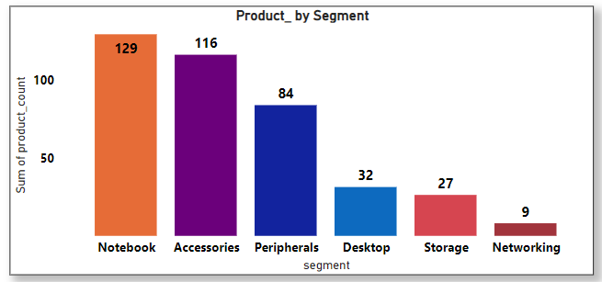
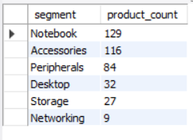
Output:
Insights:
The notebook segment has the highest number of unique products. i.e., 129 and hold 32.4% of segment products, and the networking has the lowest number of unique products. i.e., 9 and hold 2.75% of segment products.

Slide 9
Requests: 4
Follow-up: Which segment had the most increase in unique products in 2021 vs 2020? The final output contains these fields, segment product_count_2020 product_count_2021 difference.
MySql Query:
WITH cte1 AS (SELECT segment, COUNT(DISTINCT p.product_code) AS product_count_2020 FROM dim_product p JOIN fact_manufacturing_cost m ON p.product_code = m.product_code WHERE cost_year = 2020 GROUP BY segment),cte2 AS (SELECT segment, COUNT(DISTINCT p.product_code) AS product_count_2021 FROM dim_product p JOIN fact_manufacturing_cost m ON p.product_code = m.product_code WHERE cost_year = 2021 GROUP BY segment)SELECT cte1.segment, cte1.product_count_2020, cte2.product_count_2021, cte2.product_count_2021 - cte1.product_count_2020 AS differenceFROM cte1JOIN cte2 ON cte1.segment = cte2.segmentORDER BY difference DESC;

Slide 10
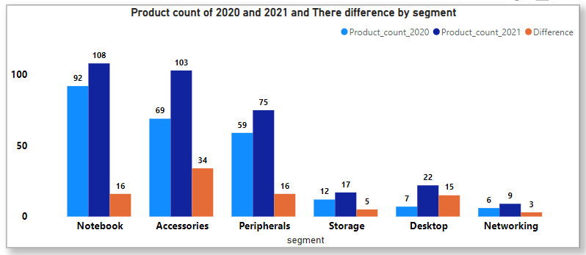
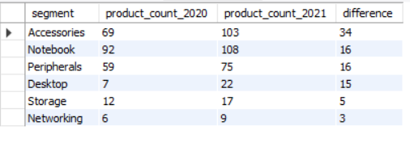
Output:
By viewing the above graph chart, it is clear that every segment product count has increased in 2021 compared to the previous year, in which the accessory segment had the highest product count compared to the previous year's count. i.e., the product count has increased by 34.
Insights:

Slide 11
Requests: 5
Get the products that have the highest and lowest manufacturing costs. The final output should contain these fields, product_code product manufacturing_cost
MySql Query:
(SELECT dim_product.product_code, dim_product.product, fact_manufacturing_cost.manufacturing_cost FROM dim_product JOIN fact_manufacturing_cost ON dim_product.product_code = fact_manufacturing_cost.product_code ORDER BY fact_manufacturing_cost.manufacturing_cost DESC LIMIT 1) UNION
(SELECT dim_product.product_code, dim_product.product, fact_manufacturing_cost.manufacturing_cost FROM dim_productJOIN fact_manufacturing_cost ON dim_product.product_code = fact_manufacturing_cost.product_code ORDER BY fact_manufacturing_cost.manufacturing_cost ASC LIMIT 1);

Slide 12

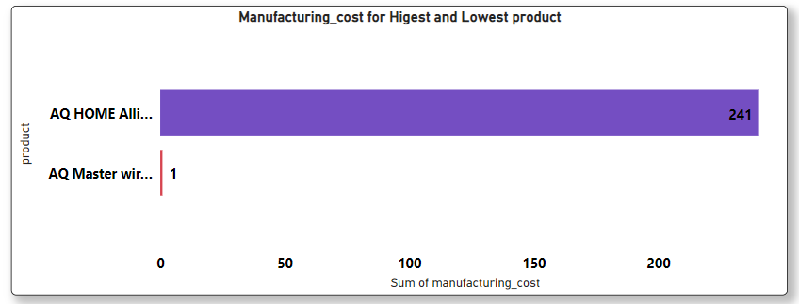
Output:
Insights:
“AQ HOME Allin 1 Gen 2” has the highest manufacturing cost value, i.e., 240.5364.
And “AQ Master Wired x1 Ms” has the lowest manufacturing cost value, i.e., 0.8920.

Slide 13
Requests: 6
Generate a report which contains the top 5 customers who received an average high pre_invoice_discount_pct for the fiscal year 2021 and in the Indian market. The final output contains these fields, customer_code customer average_discount_percentage
MySql Query:
select c.customer_code,c.customer,round(avg (f.pre_invoice_discount_pct),3) as Average_Discount_percentage from dim_customer c join fact_pre_invoice_deductions f on c.customer_code=f.customer_code where fiscal_year=2021 and market='India' group by c.customer,c.customer_code order by Average_Discount_percentage desc LIMIT 5;

Slide 14
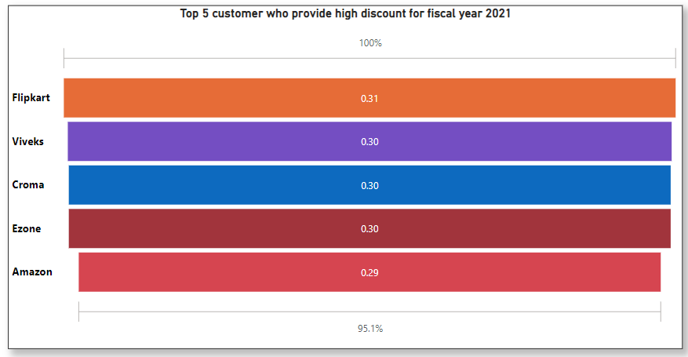
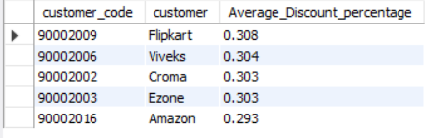
Output:
Insights:
The above chart shows the top 5 customers, i.e., Flipkart,Viveks,Croma, Ezone, and Amazon, who received a high average discount percentage for the fiscal year 2021, with Flipkart on the top of the list.

Slide 15
Requests: 7
Get the complete report of the Gross sales amount for the customer “Atliq Exclusive” for each month. This analysis helps to get an idea of low and high-performing months and take strategic decisions. The final report contains these columns: Month Year Gross sales Amount
MySql Query:
select c.customer,month(m.date) as months,year(m.date) as years,round((sum(f.gross_price*m.sold_quantity)),3) as Gross_sales_Amount from fact_gross_price f join fact_sales_monthly m on m.product_code=f.product_code join dim_customer c on m.customer_code=c.customer_code where customer='Atliq Exclusive' group by months,years order by years,months asc;

Slide 16
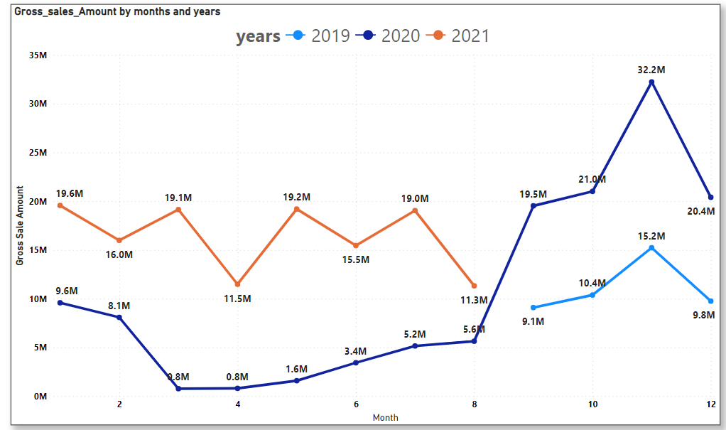
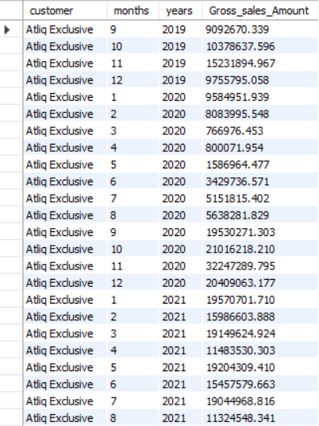
Output:
From the above line chart we can understand the pattern of the gross sales per month for year 2019,2020 and 2021, it is Cleary showing that in year 2021 gross sales per month have been increase compare to previous year. September month has the highest gross sales for year 2019 and 2020 so we can predict that in year 2021 September month will achieve the highest gross sales. For do so we can keep offer or giving discount which help us to achieve our to increase the gross sales in year 2021.
Insights:

Slide 17
Requests: 8
In which quarter of 2020, got the maximum total_sold_quantity? The final output contains these fields sorted by the total_sold_quantity, Quarter total_sold_quantity
MySql Query:
select concat('Quarter',quarter(date)) as Quaters,sum(sold_quantity) as Quantity from fact_sales_monthly where year(date)=2020group by
quarter(date) order by Quantity desc;

Slide 18
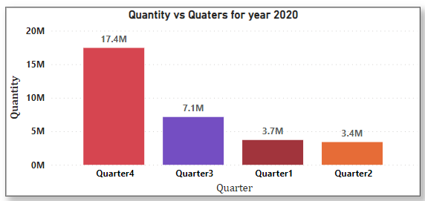
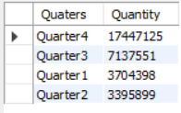
Output:
Insights:
In the year 2020, Quarter 4 has sold the highest quantity. i.e., 17447125, and quarter 2 has sold the lowest quantity. i.e. 3395899

Slide 19
Requests: 9
Which channel helped to bring more gross sales in the fiscal year 2021 and the percentage of contribution? The final output contains these fields, channel gross_sales_mln percentage
MySql Query:
(with CTE as (selectchannel,round(sum(gross_price*sold_quantity)/1000000,2) as gross_sales_mln from dim_customer as c inner join fact_sales_monthly as son c.customer_code=s.customer_codeinner join fact_gross_price as g on g.product_code =s.product_code where s.fiscal_year=2021 and g.fiscal_year=2021 group by channel order by gross_sales_mln desc)select channel,gross_sales_mln,round(((gross_sales_mln/(select sum(gross_sales_mln)from CTE ))*100),2) as percentage from CTE);

Slide 20
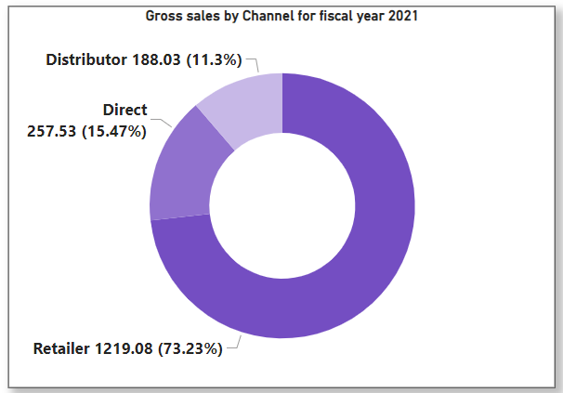
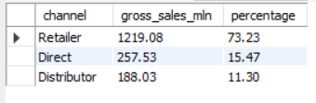
Output:
Insights:
Retailer channel helped to bring more gross sales .i.e. 1219.08 in the fiscal year 2021 and hold the 73.23 % of contribution and 26.77% of gross sales hold by the Direct and Distributors.

Slide 21
Requests: 10
Get the Top 3 products in each division that have a high total_sold_quantity in the fiscal_year 2021? The final output contains these fields, division product_code , product,total_sold_quantity, rank_order
MySql Query:
(with CTE as (select Division,p.product_code, product,sum(sold_quantity) as Total_sold_quantity from dim_product as p inner join fact_sales_monthly as s on p.product_code=s.product_code where fiscal_year=2021 group by product),CTE2 as (select Division,product_code,Product,Total_sold_quantity, dense_rank() over(partition by Division order by Total_Sold_quantity desc)Rank_order from CTE) select*from CTE2 where Rank_order<4);

Slide 22
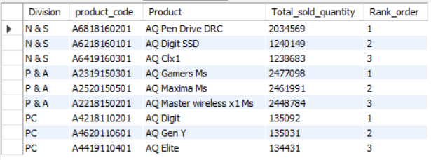
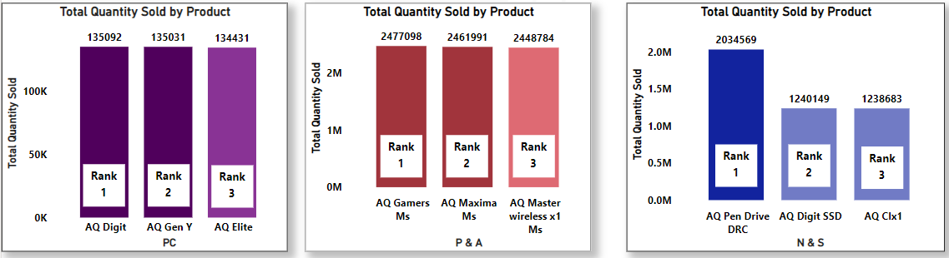
Output:
In above graph chart shows Top 3 product Division wise.In Division "N & S," the product AQ Pen Drive DRC ranks first with a total quantity of 203456. In Division "P & A" product, AQ Gamers Ms rank 1st by selling the total quantity of 2477098, and in Division "PC product, AQ Digit Rank 1st by selling the total quantity of 135092. Among the divisions, "N & S" rank first, "P & A" rank second, and "PC" rank third.
Insights:

